Slide 1
Reform and Renewal in the Church
Chapter 14

Slide 2
The Protestant Reformation
Protestant
Reformation
Protest -a statement or action expressing disapproval of or objection to something.
Reform - make changes in (something, typically a social, political, or economic institution or practice) in order to improve it.

Slide 3
The Condition of the Church (ca 1400–1517)
Signs of Disorder
Clerical immorality - priests frequently violated their vows of celibacy. They were also accused of drunkenness, gambling, and other vices.
Clerical ignorance - many priests could barely read or write. They were less educated than most educated laity.
Clerical absenteeism and pluralism¾especially in higher-level Church officials who were often absent from their sees. Many held more than one office at a time, and some had bought their offices.
Many Italian officials in Rome held benefices in England, France, or Germany, drawing income therefrom, but doing little for their sees.
Upper levels of the Church hierarchy were dominated by aristocrats who lived well.

Slide 4
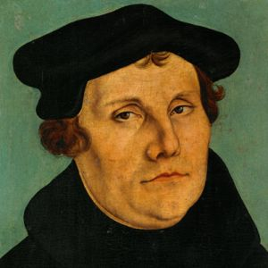
Martin Luther and the Birth of Protestantism
Luther’s Early Years
Luther was a conscientious friar, but observance of the religious routine did not bring him a sense of security in salvation.
Eventually he concluded that only simple faith in Christ led to salvation.

Slide 5
The Ninety-five Theses
In Luther’s home of Wittenburg in 1517 the Church was selling indulgences to raise money for the construction of St. Peter’s Basilica in Rome
By the 1500s common people believed that when they purchased an indulgence, they were purchasing from the Church full remission of penalties for sin.
Luther rejected the notion that good works, such as donating money to the Church through an indulgence, could lead to salvation. He was disturbed that Church friars were misleading the common people and wrote to his archbishop in protest.

Slide 6
The Ninety-five Theses
In 1519 Luther challenged the authority of the Pope (and of a general church council) in public debate. He was excommunicated.
Holy Roman Emperor Charles V declared Luther an outlaw, but Duke Frederick of Saxony sheltered him.
Ulrich Zwingli, a Swiss priest, joined the Reformation in 1519, denouncing indulgences, monasticism, and celibacy. Like Luther, Zwingli insisted the laity should read the Bible.

Slide 7
Protestant Thought
Luther maintained that God’s grace alone, without any element of individual good works, saved people.
Luther held that religious authority resided in Scripture alone, not Scripture in combination with traditional Church teachings.
Luther asserted that the Church consisted of the whole community of believers, not just the clergy.
Luther argued that all vocations were equally holy, and that monasticism was not a higher vocation.
Luther emphasized the invisible Church of all believers, not the visible hierarchy culminating in the Pope.

Slide 8
Protestant Thought
Luther maintained that God’s grace alone, without any element of individual good works, saved people.
Luther held that religious authority resided in Scripture alone, not Scripture in combination with traditional Church teachings.
Luther asserted that the Church consisted of the whole community of believers, not just the clergy.
Luther argued that all vocations were equally holy, and that monasticism was not a higher vocation.
Luther emphasized the invisible Church of all believers, not the visible hierarchy culminating in the Pope.

Slide 9
Social Impact
Even before Luther city governments in Germany had been expressing resentment of clerical privilege and immunities.
Even before Luther town burghers, disgusted with the poor quality of priestly teaching, had endowed preacherships to support good preachers.
Luther’s writing that “a Christian man is the most free lord of all” contributed to peasant unrest in Germany.
Following crop failures in 1523 and 1524, Swabian peasants in 1525 demanded an end to death taxes, new rents, and noble seizure of village common lands.

Slide 10
Social Impact
Luther initially backed the peasants.
When the peasants turned to violence, however, Luther egged the lords on as they crushed the rebellions.
Lutheranism came to exalt the state and subordinate church to the secular rulers.
Luther owed his success to the printing press, which helped him to spread his message, and to his own rhetorical skill.
Luther’s claim that all vocations have equal merit, the Protestant rejection of monasticism and celibacy, the insistence that all laity (including women) should read the Bible, and Luther’s acceptance of sexual desire (within marriage) all contributed to some improvement in women’s circumstances.

Slide 11
Germany and the Protestant Reformation
The Rise of the Habsburg Dynasty
In 1477 the marriage of Maximilian I of the House of Habsburg and Mary of Burgundy united the Austrian Empire with Burgundy and the Netherlands, making the Habsburgs the strongest ruling family in the Holy Roman (German) Empire.
The Habsburg Charles V (1500–1558) inherited Spain, and Spanish possessions in Italy, Sicily, and Sardinia, in addition to the lands mentioned above.
In 1519 Charles was elected Holy Roman Emperor. He believed that it was his duty to maintain the unity of Christendom.
Many German princes converted to Lutheranism because it allowed them to seize Church property.
Between 1521 and 1555 Charles V fought a series of wars with France over Burgundy. The French supported Lutheran princes within Germany against Charles.
In the Peace of Augsburg (1555) Charles accepted the religious status quo in Germany.

Slide 12
The Growth of the Protestant Reformation
Calvinism
Much of northern Europe broke with the Roman Church by 1555.
Calvinism was the most important new form of Protestantism.
Proceeding from the idea of God’s absolute sovereignty and his omnipotence, the founder of Calvinism, John Calvin, concluded that human beings could do nothing to save themselves. God decided at the beginning of time who would be saved and who would not (predestination).
Predestination did not lead to fatalism. Rather, Calvinists, convinced they were saved, were ready to endure great hardship in the struggle against evil.
Calvin and the city government of Geneva attempted to regulate people’s conduct in order to create a godly city on earth. Card playing, dancing, and so on were banned.
The Genevan government prosecuted heretics, burning fifty-eight at the stake between 1542 and 1546, including the Spanish heretic Servetus.
The Calvinist ethic of “the calling” glorified all vocations as pleasing to God. This doctrine encouraged hard work and vigorous activism.

Slide 13
The Growth of the Protestant Reformation
The Anabaptists
Anabaptists believed in adult baptism, religious tolerance, and separation of church and state. They shared property and admitted women as ministers.
Catholics, Lutherans, Calvinists, and Zwinglians all recognized the doctrine of separation of church and state as pointing toward a secular society, and they persecuted Anabaptists.

Slide 14
The Growth of the Protestant Reformation
The English Reformation
The Catholic Church was vigorous in early sixteenth century England and there was less of a gap between clergy and educated laypeople than elsewhere in Europe.
In 1534, in order to legitimize his divorce and subsequent marriage to Anne Boleyn, English King Henry VIII convinced Parliament to approve the Act of Supremacy, making him head of the English Church.
Later, Henry seized monasteries and distributed their lands to the upper classes.
Elizabeth I (r. 1558–1603), daughter of Henry VIII, steered a middle course between Catholicism and the “Puritans” who wanted a “pure” church free of Catholic influences.

Slide 15
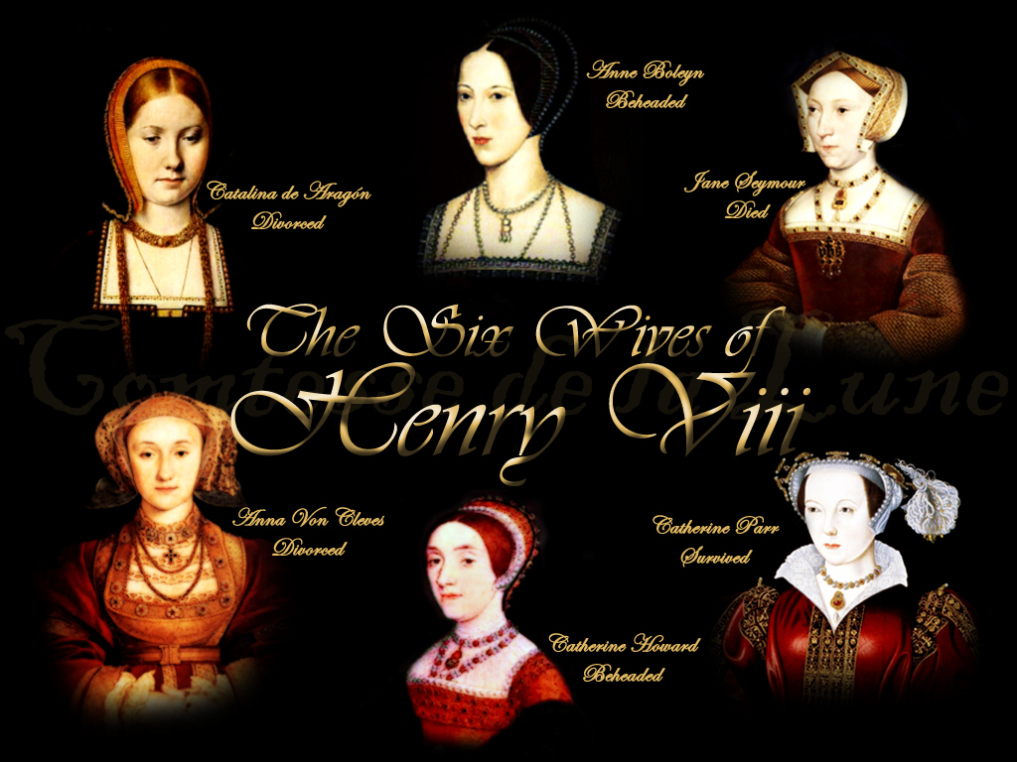

Slide 16
The Growth of the Protestant Reformation
The Establishment of the Church of Scotland
1. Scottish nobles tended to support the Reformation, while the monarchs, King James V and his daughter Mary (r. 1560–1567), opposed it.
James Knox, a minister who studied in Geneva with Calvin, was instrumental in getting the Scottish Parliament to set up a Calvinist church as the official state church of Scotland (Presbyterianism).
Protestantism in Ireland
Although the English tried to impose their church on Ireland, the Irish resisted and remained Roman Catholic.

Slide 17
The Growth of the Protestant Reformation
Lutheranism in Sweden, Norway, and Denmark
In Sweden, Norway, and Denmark, monarchs took the lead in initiating the Reformation.
The sixteenth century saw the establishment of Lutheranism and the consolidation of the Swedish monarchy.
Christian III of Denmark and Norway secularized church property and set up a Lutheran church.

