Slide 1
Absolutism and Constitutionalism
Chapter 16

Slide 2
Absolute Monarchs
In the seventeenth and eighteenth centuries absolute monarchs claimed absolute sovereignty based in divine right.
Absolute monarchs strove to eliminate competing jurisdictions and institutions in their territories. They also secured the cooperation of the nobility.
In contrast to medieval monarchs who negotiated taxation with nobles on a case-by-case basis, absolute monarchs set up bureaucracies that they controlled to collect taxes on a regular basis.
Absolute monarchs maintained permanent standing armies.
Absolutist states were not totalitarian because they lacked the financial, military, and technological resources to exercise total control over society.
Like twentieth century totalitarian states, the absolutist regimes glorified the state above all and used war to divert attention from domestic problems.

Slide 3
Absolutism
The Absolute Monarchy of Louis XIV
Louis XIV secured the collaboration of the nobility in projects that increased his prestige and theirs.
Louis XIV’s royal court at Versailles was a tool of state policy, overawing subjects and visiting dignitaries. Other European monarchs constructed their own versions of Versailles.
French language and culture became fashionable at courts all over Europe.
Louis used court ceremonies, entertainments, spies, and informers to reduce the power of the great nobility.
Louis staffed his administration with members of the nobility of the robe or the upper middle class, to show that he was not going to share power.

Slide 4
Absolutism
Financial and Economic Management under Louis XIV: Colbert
Financial problems weakened Louis XIV’s administration.
Tax revenues usually fell fall short of the government’s needs.
In Louis XIV’s France, tax exemptions for elites placed the greatest tax burden on the peasantry.
Louis’s chief financial minister, Jean-Baptiste Colbert, used subsidies for domestic industries, tariffs, and policies to attract foreign artisans in order to make France self-sufficient and to boost French exports (mercantilism).
Colbert expanded the French navy and merchant marine and promoted colonization of French territories in North America.

Slide 5
Absolutism
The Revocation of the Edict of Nantes
In 1685 Louis XIV formally revoked the Edict of Nantes because he viewed it as an affront to his own claims to power.
The French monarchy had never intended religious toleration to be permanent.
Religious liberty was not a popular policy.
French Classicism
French “classicism” refers to imitation of Roman and Greek artistic models together with the values of discipline, restraint, and balance in art.
After the 1660s French artists and musicians generally had to glorify the state and Louis himself.
Nicholas Poussin exemplifies French classicism in painting (Rape of the Sabine Women), Jean-Baptiste Lully in music, and Moliere and Racine in theater.

Slide 6
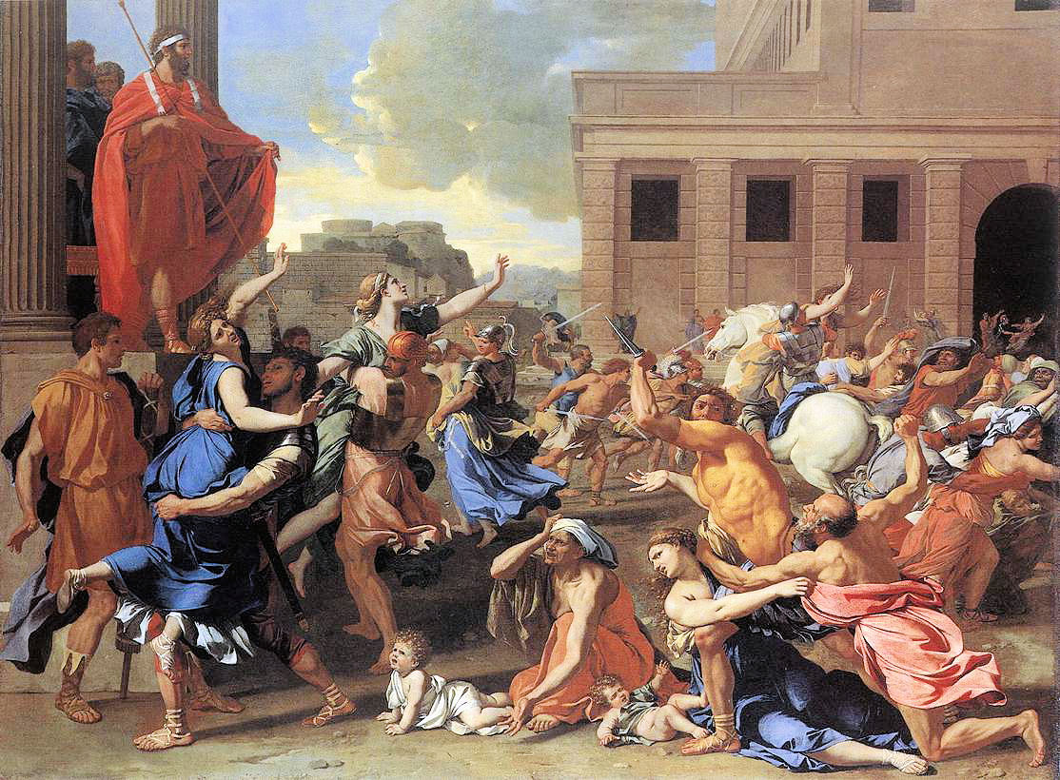

Slide 7
Absolutism
Louis XIV’s Wars
Louis was a conqueror of France was at war for thirty-three of the fifty-four years of his reign.
Louis developed a large, efficient, disciplined army subordinate directly to himself.
Louis made territorial gains in the Low Countries and Lorraine before his armies ran out of steam in the early 1680s.
High taxes to support the military and bad weather from 1688-1694 led to mass starvation in some areas of France.
After the death of King Charles II of Spain in 1700 passed the Spanish throne to Louis XIV’s grandson, England, Holland, Austria, and Prussia united against France to preserve the European balance of power and check French maritime expansion in the Americas, Asia, and Africa. This conflict became known as the War of the Spanish Succession.
The war, which ended in 1713 with the Peace of Utrecht, checked France, finished Spain as a great power, and expanded England’s overseas empire.

Slide 8
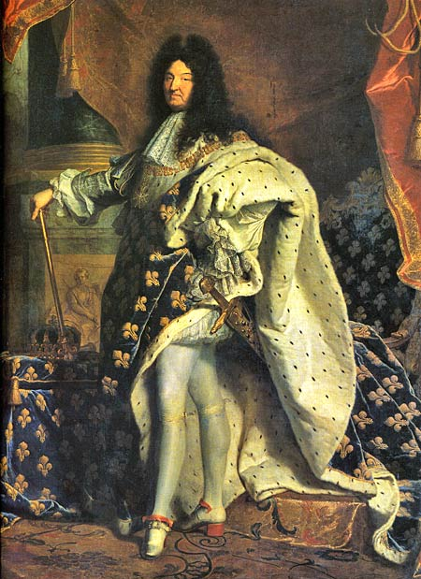

Slide 9
Absolutism
The Decline of Absolutist Spain in the Seventeenth Century
Spanish absolutism preceded that of the French. In the 1500s the kingdom of Castile developed the characteristics of an absolute monarchy.
Gold and silver from the Americas were the basis for Spanish power.
The lack of a middle class (due in part to the expulsion of Moors and Jews), agricultural crisis, population decline, and failure to invest in productive enterprises meant that by 1715 Spain was a second-rate power.
Spain extended itself in wars it could not afford in the 1600s.

Slide 10
Constitutionalism
The Constitutional State
Constitutionalism is the limitation of government by law.
A nation’s constitution can be written or unwritten.
Constitutional government can take a monarchical or republican form.
A constitutional government is not the same as a democratic government.

Slide 11
Constitutionalism
The Decline of Royal Absolutism in England (1603–1649)
In spite of a disordered and bloody seventeenth century, England emerged a constitutional monarchy.
Elizabeth I’s successor James I asserted his divine right to absolute power, antagonizing Parliament.
The House of Commons, the members of which were largely members of a new wealthy and powerful capitalist class in England, objected.
Religious Issues
James and his successor, Charles I (r. 1625-1649) appeared to be sympathetic to Catholicism; Puritans in the House of Commons were suspicious.
In 1640 Charles had to summon Parliament to request funding to suppress a rebellion in Scotland (against the imposition of Anglican liturgy).
As Parliament passed laws limiting Charles’s powers, an Irish uprising precipitated civil war.
In spite of the execution of Charles I in 1649 by Parliament, the civil war did not resolve the problem of sovereignty. England was a military dictatorship run by Parliament’s most successful general, Oliver Cromwell, from 1649-1660.

Slide 12
Constitutionalism
Puritanical Absolutism in England: Cromwell and the Protectorate
Oliver Cromwell attempted to create a community of puritanical saints.
When he died in 1658, most English had had enough of this.
The Restoration of the English Monarchy
Charles II (r. 1660-1685), invited back to England from exile in France, attempted to conciliate Parliament by creating an advisory council of five men who were also members of Parliament.
When Charles was caught in 1670 in secret negotiations with Louis XIV for subsidies in exchange for a gradual Catholicization of England and an alliance against the Netherlands, panic swept England.
When James II (r. 1685-1688), an open Catholic, succeeded Charles II, there was trouble.
James placed many Catholics in high administrative positions and declared universal religious tolerance. Seven Anglican bishops responded by refusing to read James’s proclamation. They were arrested but subsequently acquitted.
When James’s wife produced a son, there was fear that a Catholic dynasty was now assured. Parliament offered the throne to James’s Protestant daughter Mary and her Dutch husband, Prince William of Orange. In December 1688 James fled to France and William and Mary were crowned king and queen of England.

Slide 13
Constitutionalism
The Triumph of England’s Parliament: Constitutional Monarchy and Cabinet Government
The “Glorious Revolution” Parliament’s expulsion of James was guaranteed by a Bill of Rights passed by Parliament. The Bill guaranteed the independence of the judiciary, the sole power of Parliament to make laws, and freedom of debate in Parliament. All Protestants were granted religious toleration.
John Locke’s Second Treatise of Civil Government (1690) was a defense of the Glorious Revolution. Locke maintained that government was a contract between ruled and ruler for the protection of life, liberty, and property.
The Glorious Revolution was not a democratic revolution, because few English subjects could vote in the election of Parliament.
The cabinet system of government evolved in the eighteenth century. In this system a cabinet of ministers responsible primarily to Parliament governed. The power of the monarch grew weaker and weaker.

Slide 14
Constitutionalism
The Dutch Republic in the Seventeenth Century
The Dutch system of government rested on assemblies of wealthy merchants in each of the seven provinces called “Estates.”
A federal assembly, or “States General,” ran foreign policy, but was responsible to the provincial “Estates.”
The States General appointed a representative or stadtholder in each province. Some men held the post of stadtholder in all seven provinces.
The cohesion and power of the Dutch Republic ultimately rested on its immense commercial power and prosperity.
The Netherlands was the only realm in early modern Europe with almost complete religious toleration.
In 1650 the Dutch owned half of the ships in Europe and controlled much of European trade.
In the seventeenth century the Dutch probably had the highest standard of living in the world.
Dutch power began to decline around the time of the War of the Spanish Succession.

