Slide 1
European Society in the Age of the Renaissance
Chapter 13

Slide 2
The Evolution of the Italian Renaissance
Economic Growth as the Basis of the Renaissance
Venice, Genoa, and Milan grew rich on commerce between 1050 and 1300.
Florence, where the Renaissance originated, was an important banking center by the fourteenth century.

Slide 3
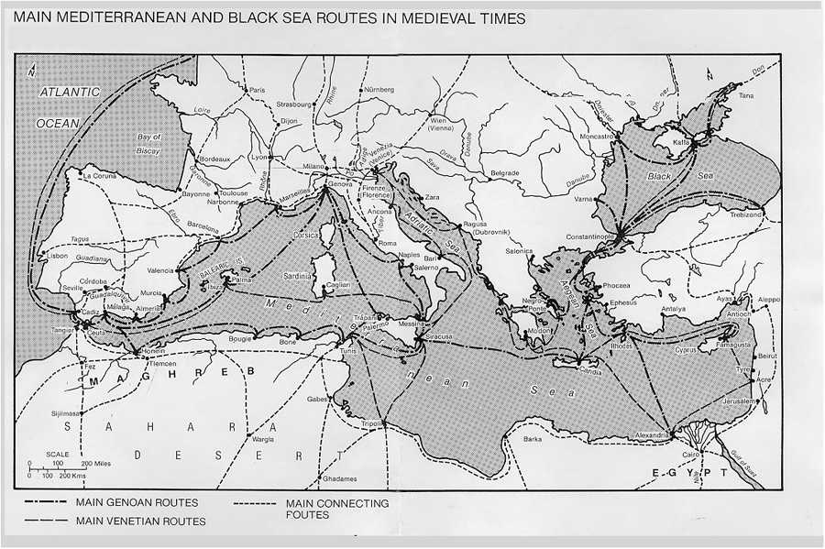

Slide 4
The Evolution of the Italian Renaissance
Communes and Republics
In northern Italy the larger cities won independence from local nobles and became self-governing communes of free men in the twelfth century.
Local nobles moved into the cities and married into wealthy merchant families.
This new class set up property requirements for citizenship.
The excluded, the popolo, rebelled and in some cities set up republics.
By 1300 the republics had collapsed, and despots or oligarchies governed most Italian cities.

Slide 5
The Evolution of the Italian Renaissance
The Balance of Power among the Italian City-States
City patriotism and constant competition for power among cities prevented political centralization on the Italian peninsula.
As cities strove to maintain the balance of power among themselves, they invented the apparatus of modern diplomacy.
In 1494 the city of Milan invited intervention by the French King Charles VIII.
Italy became a battleground as France, Spain, and the Holy Roman Emperor vied for dominance.
In 1527 the forces of Holy Roman Emperor Charles V sacked Rome.

Slide 6
Intellectual Hallmarks of the Renaissance
Individualism
Renaissance writers stressed individual personality, greatness, and achievement, in contrast to the medieval ideal of Christian humility.
Humanism
The revival of antiquity took the form of interest in archaeology, recovery of ancient manuscripts, and study of the Latin classics.
The study of the classics became known as the “new learning,” or humanism.
Humanist scholars studied antiquity not so much to find God as to know human nature and understand a different historical context.
Humanists derided what they viewed as the debased Latin of the medieval churchmen.

Slide 7
Intellectual Hallmarks of the Renaissance
Secular Spirit
The secular way of thinking focuses on the world as experienced rather than on the spiritual and/or eternal.
Renaissance thinkers came to see life as an opportunity rather than a painful pilgrimage toward God.
Lorenzo Valla argued that sense pleasures were the highest good.
Giovanni Boccaccio wrote about an acquisitive, sensual, worldly society.
Renaissance popes expended much money on new buildings, a new cathedral (St. Peter’s), and on patronizing artists and men of letters.

Slide 8
Social Change
Education and Political Thought
Humanist writers were preoccupied with education for morality and virtue.
Daughters of the elite received an education similar to sons and a few went on to become renowned painters or scholars.
In The Prince (1513), Niccolo Machiavelli argued that politics could not follow simple rules of virtue and morality—that it ought in fact to be studied as a science.

Slide 9
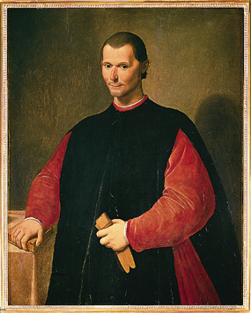
Machiavelli, portrait
Machiavelli, portrait
In this fifteenth-century portrait Machiavelli is dressed as a government official. After being exiled from Florence by the Medici, he wrote to a friend that each night when he returned from the fields he dressed again in his curial robes and pondered the behavior of governments and princes. (Scala/Art Resource, NY)
Copyright ©Houghton Mifflin Company. All rights reserved.

Slide 10
Art and the Artist
Art and Power
In the early Renaissance, corporate groups such as guilds sponsored religious art.
By the late fifteenth century individual princes, merchants, and bankers sponsored art to glorify themselves and their families. Their urban palaces were full of expensive furnishings as well as art.
Classical themes, individual portraits, and realistic style characterized Renaissance art.
Renaissance artists invented perspective and portrayed the human body in a more natural and scientific manner than previous artists did.

Slide 11
Art and the Artist
The Status of the Artist
Medieval masons were viewed as mechanical workers/artisans. Renaissance artists were seen as intellectual workers.
The princes and merchants who patronized artists paid them well.
Artists themselves gloried in their achievements. During the Renaissance, the concept of artist as genius was born.
Renaissance culture was only the culture of a very wealthy mercantile elite; it did not affect the lives of the urban middle classes or the poor.

Slide 12
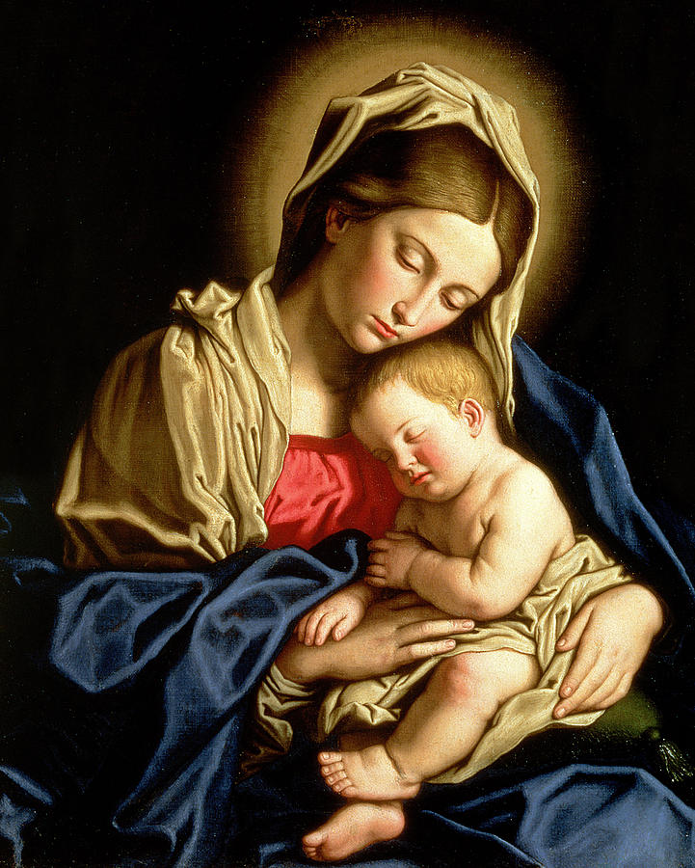
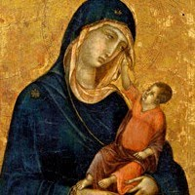

Slide 13
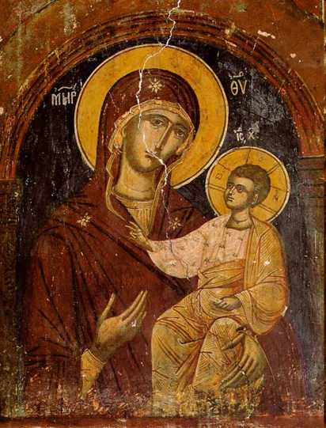
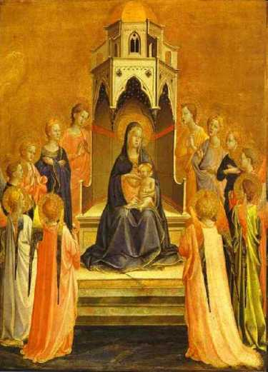
Medieval Portrayals of the Madonna

Slide 14
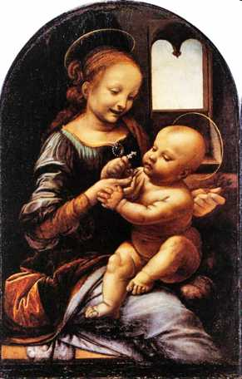
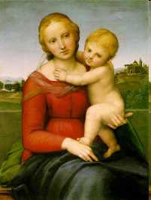
Renaissance Portrayal of the Madonna

Slide 15
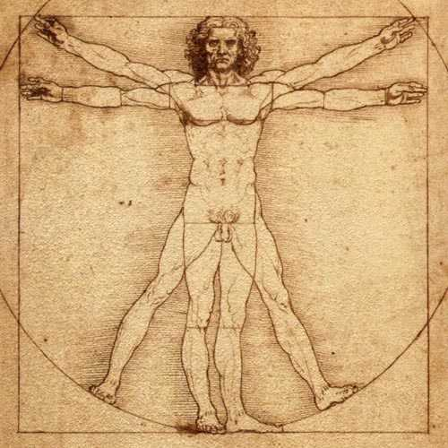

Slide 16
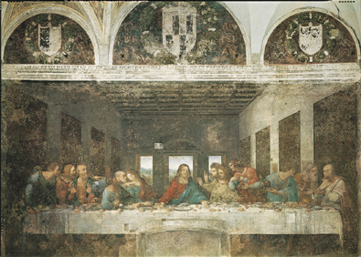
da Vinci, The Last Supper
da Vinci, The Last Supper
The works of Leonardo da Vinci--drawings, paintings, sculpture, innumerable inventions, and copious writings--exemplify the Renaissance spirit. He is, however, best known as the founder of a new style of painting. Leonardo developed two important design techniques that became standard features of High Renaissance painting. The first, circular motion, placed figures in a group so that each seemed to be leaning toward, looking at, or pointing to another figure. The second, pyramidal design, positioned one figure as if at the apex of an imaginary pyramid and then allowed the other figures to fix the corners of the pyramid. His most famous work in Milan is a mural, The Last Supper. The perspective is straightforward, with the vanishing point located immediately behind Jesus' head. The grouping of the disciples in four groups of three is equally unique. (Scala/Art Resource, NY)
Copyright ©Houghton Mifflin Company. All rights reserved.

Slide 17
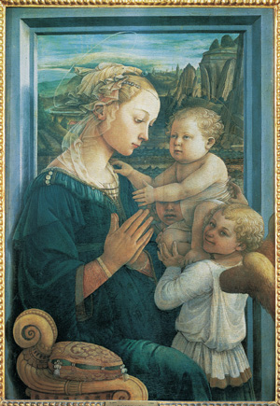
Fra Filippo Lippi, Madonna and Child
Fra Filippo Lippi, Madonna and Child
Fra (meaning brother) Filippo Lippi (ca. 1406-1469), a gifted monk, decided to become a painter after watching Masaccio paint in the Brancacci Chapel. In his later years, Filippo developed an intimate and sensual approach to painting, evidenced in his Madonna and Child with Two Angels. This Madonna is a beautiful young woman, neither fragile nor spiritual, and the Child and the angels radiate both youth and beauty. A shimmering light highlights the foreground, and the distinctly outlined figures are fully rounded by the use of this light and the shadows it creates. (Scala/Art Resource, NY)
Copyright ©Houghton Mifflin Company. All rights reserved.

Slide 18
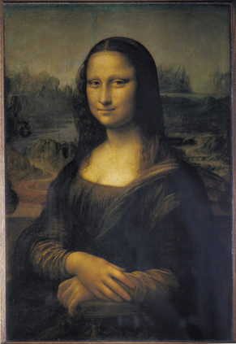
Leonardo da Vinci, Mona Lisa
Leonardo da Vinci, Mona Lisa
In 1503 Leonardo da Vinci began his most famous work--the Mona Lisa. The subject of the painting is Lisa Gherardini del Giocondo, the wife of a prominent Florentine businessman. She is posed half-length in the seated position, her posture is relaxed, and her gaze is direct. The softening of the edges of the background, effecting a fine haze called sfumato, creates a sense of intimacy and psychological drama. (Erich Lessing/Art Resource, NY)
Copyright ©Houghton Mifflin Company. All rights reserved.

Slide 19
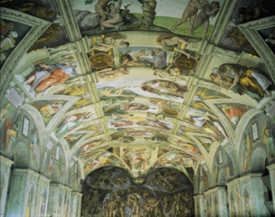
Michelangelo, Sistine Chapel ceiling
Michelangelo, Sistine Chapel ceiling
Michelangelo Buonarroti's commission to adorn the vaults of the 130-foot-long ceiling of the Sistine Chapel was the most challenging enterprise of the Renaissance. Although Michelangelo had to adapt his monumental figures to fit the contours of the ceiling, they remain highly expressive and communicate his belief that physical beauty manifested the spiritual beauty of the soul. The nine central panels portray the world described in Genesis from Creation to the Drunkenness of Noah. In the sections above the windows and in the lunettes around the windows, Michelangelo portrayed the generations of ancestors prior to Christ, and in the large corners of the chapel he depicts important scenes drawn from the Old Testament. (Vatican Museum)
Copyright ©Houghton Mifflin Company. All rights reserved.

Slide 20
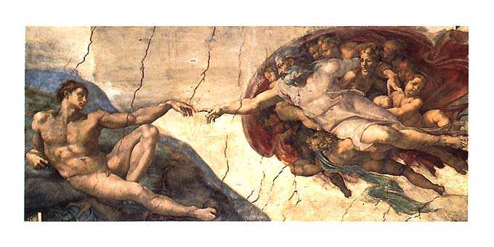
The Divine Spark

Slide 21
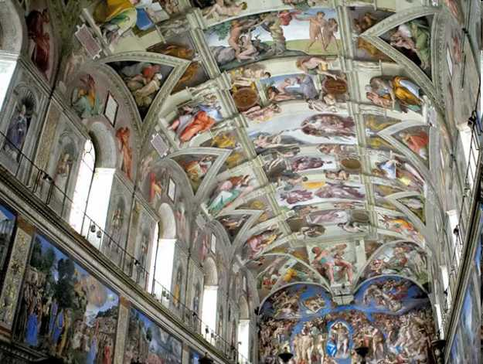
Ceiling of the Sistine Chapel

Slide 22
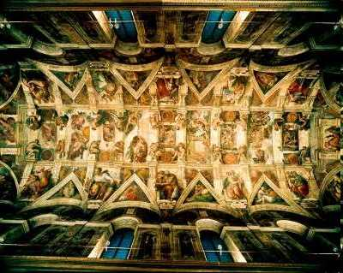

Slide 23
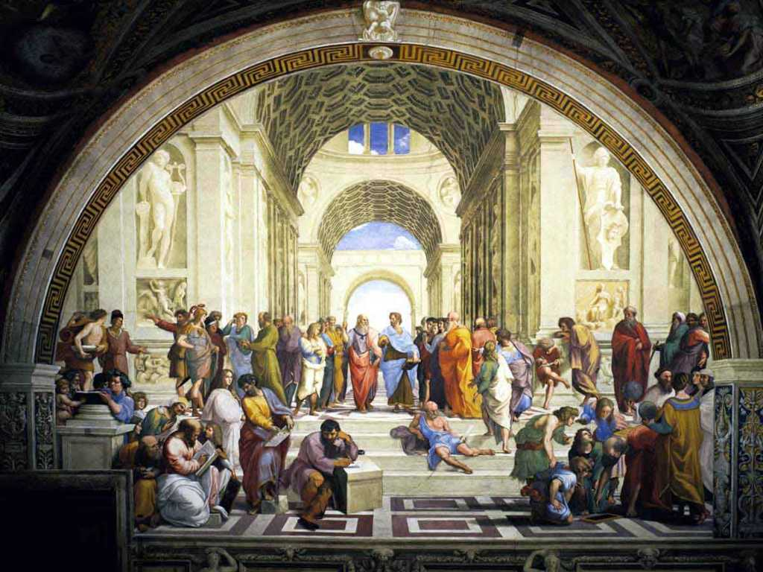

Slide 24
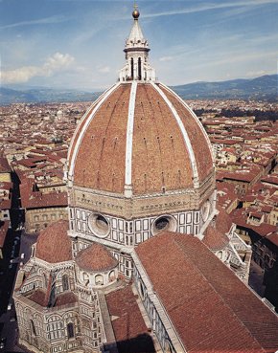
Brunelleschi, Dome of Cathedral
Brunelleschi, Dome of Cathedral
Filipo Brunelleschi, the foremost architect of the early Renaissance, lost the competition for the commission for the north door of the Baptistery to Ghiberti. In 1417 he bested Ghiberti, and won the commission to build a dome for the Florentine Cathedral. Between 1420 and 1436 he built a drum, a vertical supporting wall, on the existing 138-foot-diameter octagonal cross of the cathedral. He then assembled the dome on the drum, essentially creating an eight-sided Gothic vault. (Scala/Art Resource, NY)
Copyright ©Houghton Mifflin Company. All rights reserved.

Slide 25
Social Change
The Printed Word
Around 1455 in the German city of Mainz, Johan Gutenberg and two other men invented the movable type printing press.
Methods of paper production had reached Europe in the twelfth century from China through the Near East.
Printing made government and Church propaganda much more practical, created an invisible “public” of readers, and stimulated literacy among laypeople.

Slide 26
Social Change
Women and Work
Early modern culture identified women with marriage and the domestic virtues.
Women were involved with all economic activity connected with the care and nurturing of the family, as well as working outside the home.
Women during the Renaissance worked in a variety of businesses—for example, sailmaking—and even in a few isolated cases managed large enterprises.
Wealthy women were usually excluded from the public arena and instead managed their households.

Slide 27
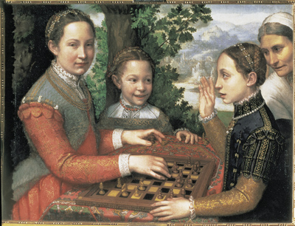
Anguissola, Portrait of Artist's Three Sisters
Anguissola, Portrait of Artist's Three Sisters
Sofonisba Anguissola (ca. 1535-1625) was the first Italian woman to be widely recognized as an artist during her lifetime. Because women were not permitted to study anatomy, Sofonisba specialized in portrait paintings, infusing them with psychological truth about human emotions. In her painting Portrait of the Artist's Three Sisters with Their Governess, the scene is a suspended moment in time: as the governess looks on, the oldest sister is poised to make her next move, while the youngest sister smiles mischievously as she anticipates her other sister's countermove. (Narodowe Museum, Poznan, Poland/The Bridgeman Art Library International)
Copyright ©Houghton Mifflin Company. All rights reserved.

Slide 28
Social Change
Culture and Sexuality
Women’s status in the realm of love, romance, and sex declined during the Renaissance.
Writers such as Castiglione created the “double standard” women were to be faithful in marriage, while men need not be.
Penalties for rape in Renaissance Italy were very light.
In spite of statutes against “sodomy,” generally referring to male homosexuality, Florentine records from the fifteenth century show a lot of homosexual activity going on, usually relations between an adult male and a boy.

Slide 29
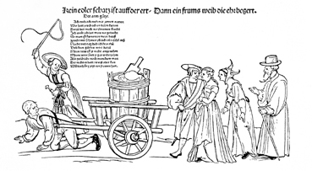
Broadsheet: "There Is No Greater …"
Broadsheet: "There Is No Greater …"
Ethard Schon's 1523 woodcut, There Is No Greater Treasure Here on Earth Than an Obedient Wife Who Desires Honor, and other similar broadsheets informed and amused Europeans of all walks of life. The image of a henpecked husband and his wife would have been instantly recognizable to most people. Accompanying texts clarified the message. Broadsheets were cheap and easy to produce and were printed on inexpensive paper. Almost anyone could afford them. (Gotha Schlossmuseum)
Copyright ©Houghton Mifflin Company. All rights reserved.

Slide 30
Social Change
Slavery and Ethnicity
In medieval and Renaissance Europe many Slavic, Tartar, Circassian, Greek, and Hungarian slaves were imported.
Beginning in the fifteenth century the Portuguese brought many black African slaves into Europe.
Within Africa the economic motives of rulers and merchants trumped any cultural/ethnic/racial hostility toward Europeans. They sold fellow Africans into slavery apparently without qualms.
Africans did not identify themselves as “black,” but as members of more than 600 different tribal and ethnic groups.
Black slaves were an object of curiosity at European courts.
The Renaissance concept of people from sub-Saharan Africa was shaped by Christian symbology of light and darkness¾blacks represented the Devil. Race did not emerge as a concept until the late seventeenth century.

Slide 31
The Renaissance in the North
Northern Humanists
In the late fifteenth century students from northern Europe studied in Italy and brought the Renaissance home.
Thomas More (1478–1535) of England argued that reform of social institutions could reduce or eliminate corruption and war.
The Dutchman Desiderius Erasmus (1466–1536) was an expert in the Bible and Greek language who believed that all Christians should read the Bible.
François Rabelais (1490–1553) ridiculed established institutions such as the clergy with gross humor in Gargantua.
Flemish artists came to rival the Italian Renaissance painters.

Slide 32
Politics and the State in the Renaissance
Some scholars have viewed Renaissance kingship as a new form, citing the dependence of the monarch on urban wealth and the ideology of the “strong king.”
In France Charles VII (r. 1422–1461) created the first permanent royal army, set up new taxes on salt and land, and allowed increased influence in his bureaucracy from middle-class men. He also asserted his right to appoint bishops in the Pragmatic Sanction of Bourges.
Charles’s son Louis XI (r. 1461–1483) fostered industry from artisans, taxed it, and used the funds to build up his army. He brought much new territory under direct Crown rule.
In England Edward IV ended the War of the Roses between rival baronial houses.
Henry VII ruled largely without Parliament, using as his advisers men with lower-level gentry origins.
Henry’s Court of the Star Chamber tried cases involving aristocrats and did so with methods contradicting common law, such as torture.

Slide 33
Politics and the State in the Renaissance
Although Spain remained a confederation of kingdoms until 1700, the wedding of Isabella of Castile and Ferdinand of Aragon did lead to some centralization. Ferdinand and Isabella stopped violence among the nobles, recruited “middle-class” advisers onto their royal council, and secured the right to appoint bishops in Spain and in the Spanish empire in America.
Popular anti-Semitism increased in fourteenth-century Spain. In 1478 Ferdinand and Isabella invited the Inquisition into Spain to search out and punish Jewish converts to Christianity who secretly continued Jewish religious practices.
To persecute converts, Inquisitors and others formulated a racial theory that conversos were suspect not because of their beliefs, but because of who they were racially.
In 1492 Ferdinand and Isabella expelled the Jews from Spain.

