Slide 1
Chapter 17
Absolutism in Eastern Europe to 1740

Slide 2
Lords and Peasants in Eastern Europe
The Medieval Background
During the period from 1050 to 1300, personal and economic freedom for peasants increased, and serfdom nearly disappeared.
After 1300, lords in eastern Europe revived serfdom to fight their economic woes.
Laws were passed that bound peasants to land and lord.
Lords confiscated peasant lands and imposed greater labor obligations on them.
The Consolidation of Serfdom
Hereditary serfdom was established or reestablished in Poland, Russia, and Prussia.
Weak monarchs could not or would not withstand their powerful nobles’ revival of serfdom.

Slide 3
The Rise of Austria and Prussia
Austria and the Ottoman Turks
In Bohemia the Habsburgs crushed the mostly Protestant nobility, bringing in Catholic newcomers and binding local peasants to them (1618-1650).
In the culturally German core of Austria the Habsburgs centralized the government and created a standing army (mid-1600s).
The Ottomans reached the peak of their power under Suleiman the Magnificent (r. 1520–1566).
The Ottoman Empire was built on a very non-European conception of state and society.
The top ranks of the bureaucracy were staffed with the sultan’s slave corp.
The Ottomans were more tolerant of religious differences than Europeans were.
Non-Muslim minorities co-existed with the Muslim majority.
After the death of Suleiman, the empire fell into decay.
The Habsburgs defeated the Turkish siege of Vienna in 1683 and began increasing their territory at Ottoman expense.
The Hungarian nobility, many of them Protestants, continued to insist on their traditional rights and won Habsburg recognition of these in 1713.

Slide 4
The Rise of Austria and Prussia
Prussia in the Seventeenth Century
The Hohenzollern family ruled the electorate of Brandenburg and Prussia.
The Thirty Years’ War weakened representative assemblies and allowed the Hohenzollerns to consolidate their rule.
Frederick William, the Great Elector (r. 1640-1688), employed military power and taxation to unify his Rhine holdings, Prussia, and Brandenburg into a strong state.
The Consolidation of Prussian Absolutism
King Frederick William I (r. 1713-1740) encouraged Prussian militarism and created the most efficient army in Europe.
Frederick helped lay the foundations of a militaristic nation.

Slide 5
The Development of Russia
The Mongol Yoke and the Rise of Moscow
The Russian aristocracy (boyars) and a free peasantry made it difficult to strengthen the state.
The princes of Moscow served the Mongol invaders as officials.
Ivan III (r. 1462-1505) assumed the leadership of Orthodox Christianity and distributed conquered land to a new class of military servicemen.

Slide 6
The Development of Russia
Tsar and People to 1689
Ivan IV (Terrible) fought wars against Mongol successor khanates in the east and Poland-Lithuania in the west.
He launched a reign of terror against the boyar nobility.
Increased pressure on the peasants to pay for his wars led to a breakdown of the Muscovite state after his death (the Time of Troubles, 1598-1613).
Michael Romanov was elected tsar by the nobility in 1613.

Slide 7
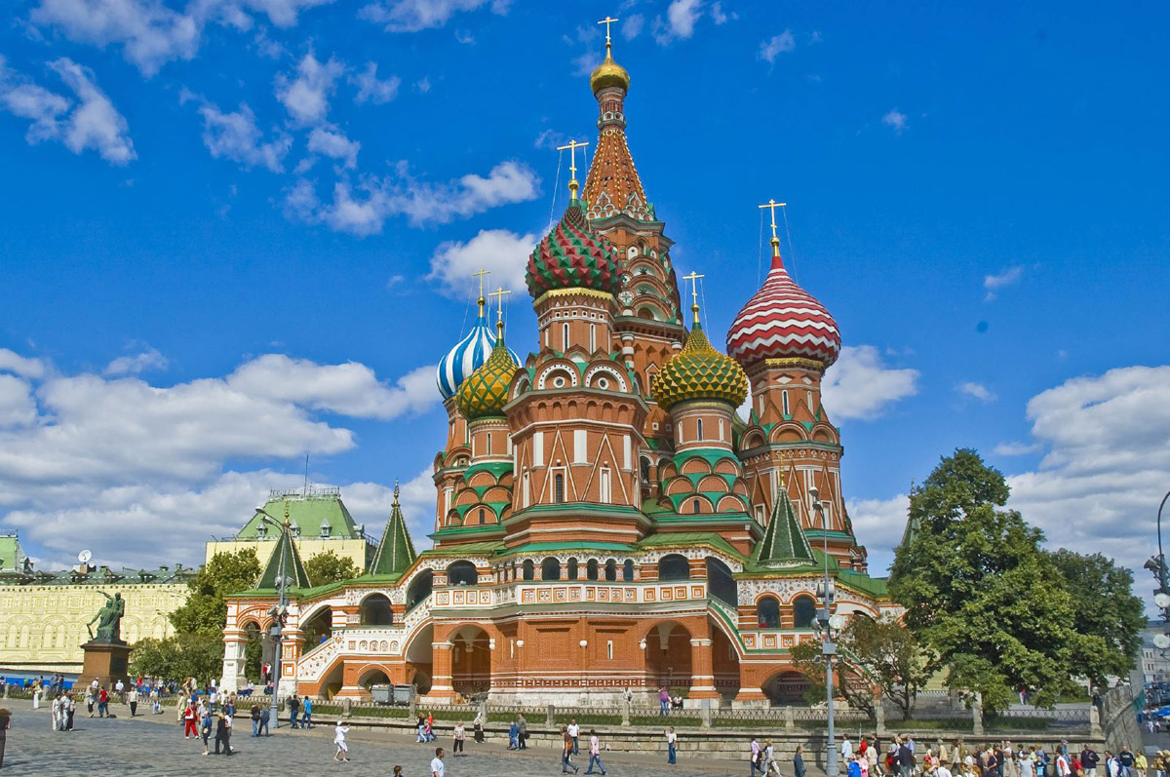
st. basil's cathedral

Slide 8
The Development of Russia
The Reforms of Peter the Great
Peter the Great sought to reform Russia to increase its military might.
He created Western-style schools to train technicians for the army.
He borrowed Western technology and hired Western advisers.
He modernized the army and made Russia a great power in Europe.
He increased the burden of serfdom to pay for Russia’s military power.

Slide 9
Absolutism and Baroque Architecture
Palaces and Power
Architecture reflected the image and power of monarchs.
The royal palace was the greatest expression of royal power.
Baroque was the dominant artistic style of the age of absolutism.
Royal Cities
Monarchs built new cities and expanded old ones to reflect their power and vision of the state.
The Growth of St. Petersburg
St. Petersburg is a good example of the ties among architecture, politics, and urban planning.
In 1702 Peter the Great began the task of building a new city.
The architectural ideas that informed the city matched Peter’s general political goals.
Peasants were forced to work on the construction of the city and nobles were ordered to build houses there.

Slide 10
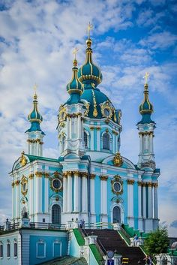
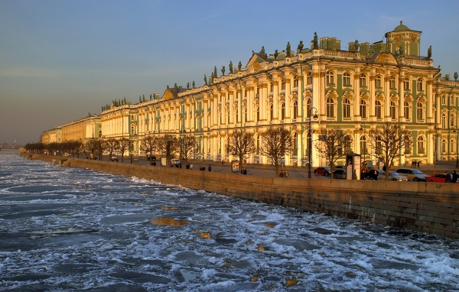
Baroque Architecture

