Slide 1
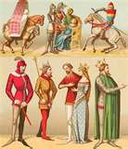
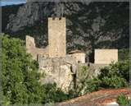
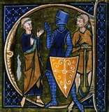
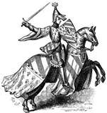
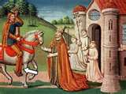
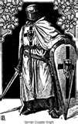
European
Feudalism

Slide 2
What lead to FEUDALISM?
Germanic invaders raided the western half of the Roman Empire
1. Constant fighting
2. Disruptions in trade
Cities no longer economic centers
3. Downfall of cities
Governments collapsed
Nobles retreat to rural areas
URBAN people move to RURAL areas

Slide 3
consequences of population shift to rural areas
literacy declined
loss of common language
Germanic invaders mixed with the Romans
only way to be educated was through Catholic Church
different languages evolved from Latin
French
Spanish
breakup of unified empire
kings couldn’t defend lands
people loyal to local leaders with armies

Slide 4
REMEMBER:
the feudal system was based on rights and obligations
Fief- granted land
Lord- the landowner, he gave permission for people to use his land
Vassal- the person using the land
Manor- the lord’s estate

Slide 5
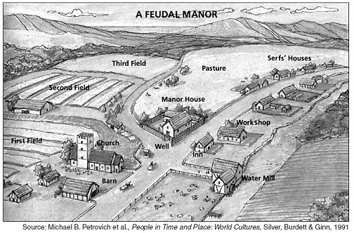

Slide 6
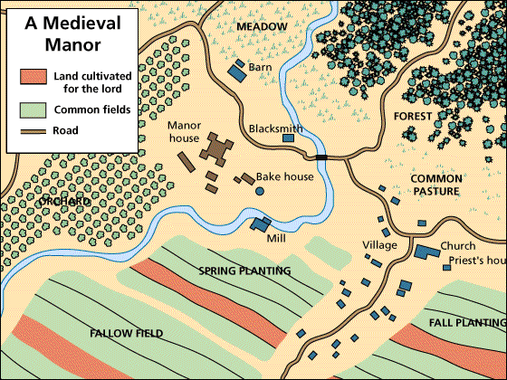

Slide 7
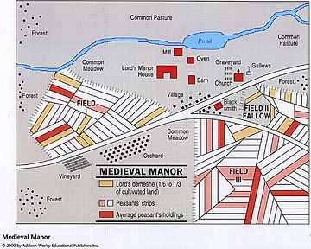

Slide 8
King
Nobles
&
Church Officials
Knights
Peasants
Serfs

Slide 9
King
The land legally belonged to the king

Slide 10
Noble
Nobles granted use of land if they
Swore loyalty to king
Gave military services to king
Powerful vassal
Wealthy
Controlled Knights

Slide 11
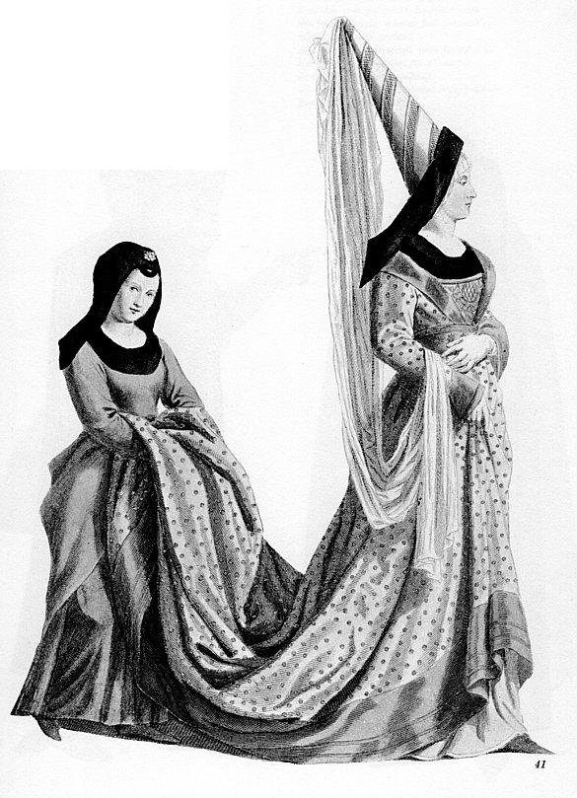
Noblewoman
Could inherit estates her husband
Held little property
Land passed to sons
Could send knights to war
If husband was off fighting
Military commander
Warrior
Basic education

Slide 12
Church Official
Powerful vassal
Church was the bond among the divided social classes
Peasant families paid a tax of one-tenth of their income (tithe) to the church

Slide 13
Knight
Nobles were always fighting each other
Needed skilled warriors to defend land
Pledged to defend land in exchanged for fiefs
Wealth from land allowed them to devote lives to war
Started training at age 7

Slide 14
Peasant
Worked land
Cared for animals
Maintained Estate
Owed lord
Several workdays a week
Portion of grain produced
Paid high taxes to live on land
Most traveled no more than 25 miles from where they were born

Slide 15
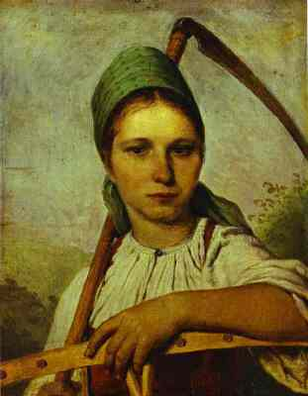
Peasant
Women
Worked next to men in fields
Ran households and had children
Girls learned household skills

Slide 16
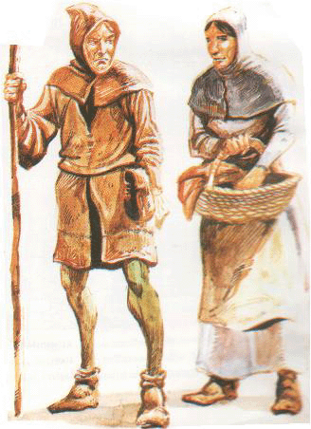
People who couldn’t leave the place they were born
Not slaves
Couldn’t be bought or sold
- all labor produced belonged to lord
Lord provided
Housing
Farmland
Protection from bandits
Created everything the lord needed
Most children didn’t survive till adulthood
Serf

Slide 17
king
Noble
Church
Official
Knights
Peasants/Serfs

