Slide 1
World Religions
Era 1: Standard 4.2

Slide 2
Types of Belief Systems
Polytheistic – Belief in MORE THAN ONE god or divine being
Examples: Buddhism, Hinduism
Monotheistic – Belief in ONE god.
Examples: Judaism, Christianity, Islam

Slide 3
Hinduism

Slide 4
Hinduism
Developed in India approximately around 3000 BCE
No Specific Founder
Currently Practiced – India
Holy Books- Vedas
Beliefs – Brahma is the Supreme Being in the Hindu religion. Hindus believe in millions of different gods and are considered manifestations of the one god Brahma. There are three main gods that control the cycle of life:
Brahma- the creator
Vishnu- the preserver of life
Shiva- the destroyer

Slide 5
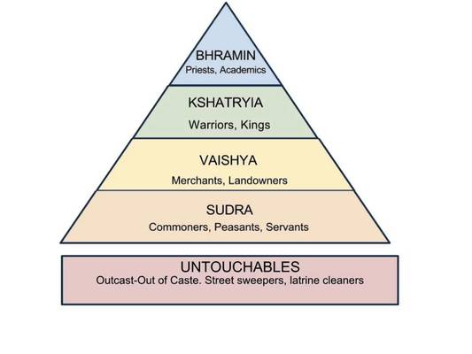
Hinduism
Reincarnation – The belief that your soul is reborn into another body
Karma – deeds (actions, words, and thoughts) that impact your future
Dharma - fulfilling one's duty or occupation in life

Slide 6
Judaism

Slide 7
Judaism
Developed in the Middle East around 1000 BCE
Founder – Abraham
Currently Practiced – Israel, U.S.
Holy Book- The Torah
Holy City – Jerusalem

Slide 8
Judaism – Beliefs
Jews believe that there is a single God (Yahweh) who not only created the universe, but with whom every Jew can have an individual and personal relationship.
They await the Messiah, who will be an earthly king. They believe in heaven, but have less focus on the afterlife.
Ten Commandments is the basic code of law.

Slide 9
Buddhism

Slide 10
Buddhism
Developed in India approximately around 500 BCE
Founder – Siddhartha Gautama
Currently Practiced – China, South East Asia
Holy Book- Tripitka, or the Three Baskets of Wisdom.
Place of Worship – Pagodas

Slide 11
Buddhism – Beliefs
Four Noble Truths –
1. Life is full of pain and suffering.
2. Human desire causes this suffering.
3. By putting an end to desire, humans can end suffering.
4. Humans can end desire by following the Eight-fold Path.

Slide 12
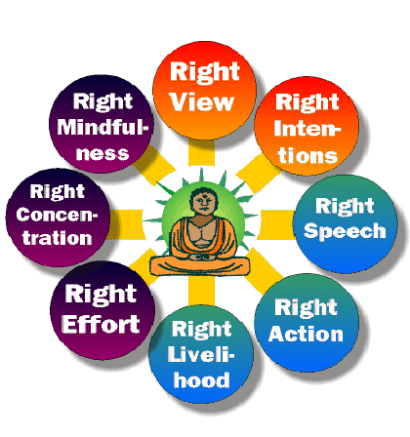
Buddhism – Beliefs
Reincarnation - A person is reincarnated until they can achieve Nirvana
Nirvana – Spiritual enlightenment

Slide 13
Christianity

Slide 14
Christianity
Christianity originated from Judaism about 30 CE.
Founder – Jesus Christ, Paul
Currently Practiced – World Wide (Largest Religion in the World)
Holy Book- The Bible
Holy City – Jerusalem

Slide 15
Christianity – Beliefs
Christians believe that Jesus was a Messiah, or savior Sent by God to bring eternal life to anyone who would follow him.
Jesus accepted the Ten Commandments and also preached equality of man before God.
Although the Romans originally felt threatened by the Christians, and therefore allowed Jesus to be crucified, Christianity eventually became the official religion of the Roman Empire.

Slide 16
Islam

Slide 17
Islam
Islam originated in the Middle East around 622 CE
Founder – Muhammad
Currently Practiced – World Wide (Fastest Growing Religion in the World)
Holy Book- The Qur’an
Holy City – Jerusalem, Mecca
Places of Worship – Mosques

Slide 18
Christianity – Beliefs
Five Pillars of Islam
Faith in one God, Allah—Mohamad is his prophet
Pray five times daily prayer toward Mecca
Give a % of their income to help the poor
Fasting during the holy month of Ramadan
Pilgrimage to holy city of Mecca - Hajj

